Slide 1
Find The Lag
HA-226520

Slide 2
Table of contents
01
03
About the project
Project Results
02
04
Project Stages
Our Team

Slide 3
01
About the project
Measure the latency between pressing the button on the mouse and the computer registering the event in a video.

Slide 4
Overview
Online gaming has drastically increased day by day and there are many issues in online gaming in which one of the biggest issues is high latency. Gamers demand low network latency, so they are not handicapped against other combatants in the multiplayer online battle arena.

Slide 5
Objective
The main objective of our project was to measure the latency between pressing the button on the mouse and the computer registering the result in a video.
We trained some model using the dataset and finding the accuracy with different algorithm and designed a webapp which is use for finding the latency.

Slide 6
02
Project stages

Slide 7
Project stages
Stage 1
Stage 2
Stage 3
Dataset is given in the form of Videos; we convert it into a CSV file & perform some visualization on the CSV dataset.
Choosing the model using different factors such as accuracy, MSE etc.
Designing the web app using Streamlit

Slide 8
Stage 1
In designing a model, the first step is the collection of the data set, We got the data set in the video form. We convert it into CSV format.
We have used the Virtual Dub 2 software to get the video in “Frame by Frame” format.
We marked the start Frame (when the user clicks input using the mouse) & we detect the end frame by observing the monitor change manually.
After getting the required information regarding the [video name, frame start, frame end, frame difference & frame time difference] we create a CSV file as shown on next slide.

Slide 9
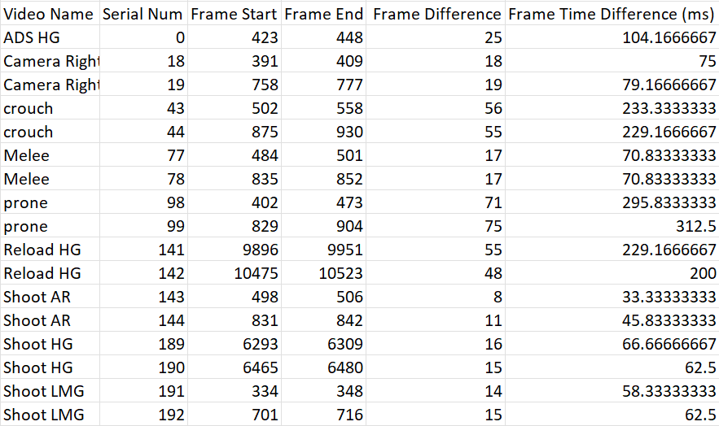
Data Set

Slide 10
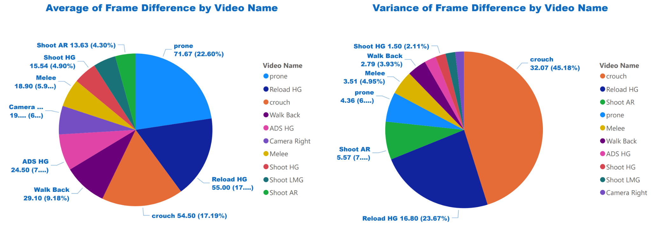
Visualizations from CSV
We have used PowerBI tools for getting insights from our dataset
We also used various statistical measures such as [mean, variance, standard deviation & many more] to get important curves and graphs from the data.
Some of our visualizations from CSV data are shown below.

Slide 11
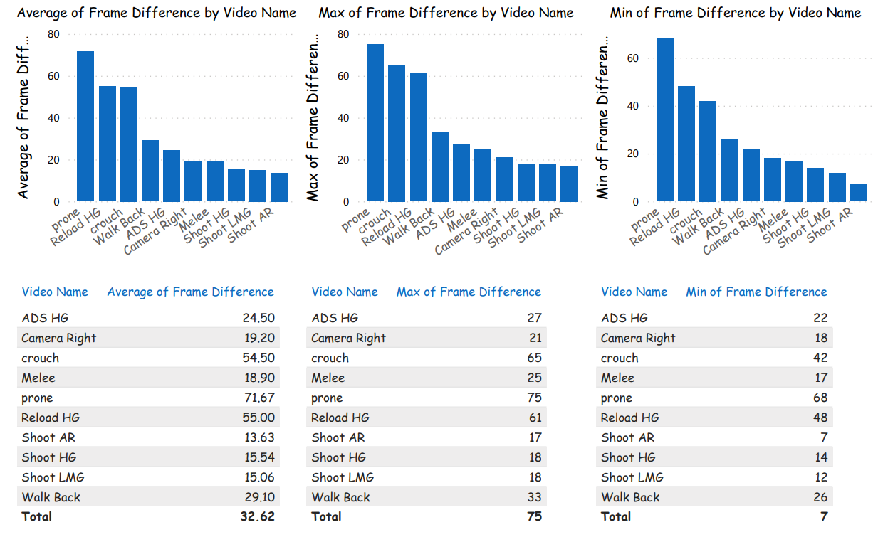

Slide 12
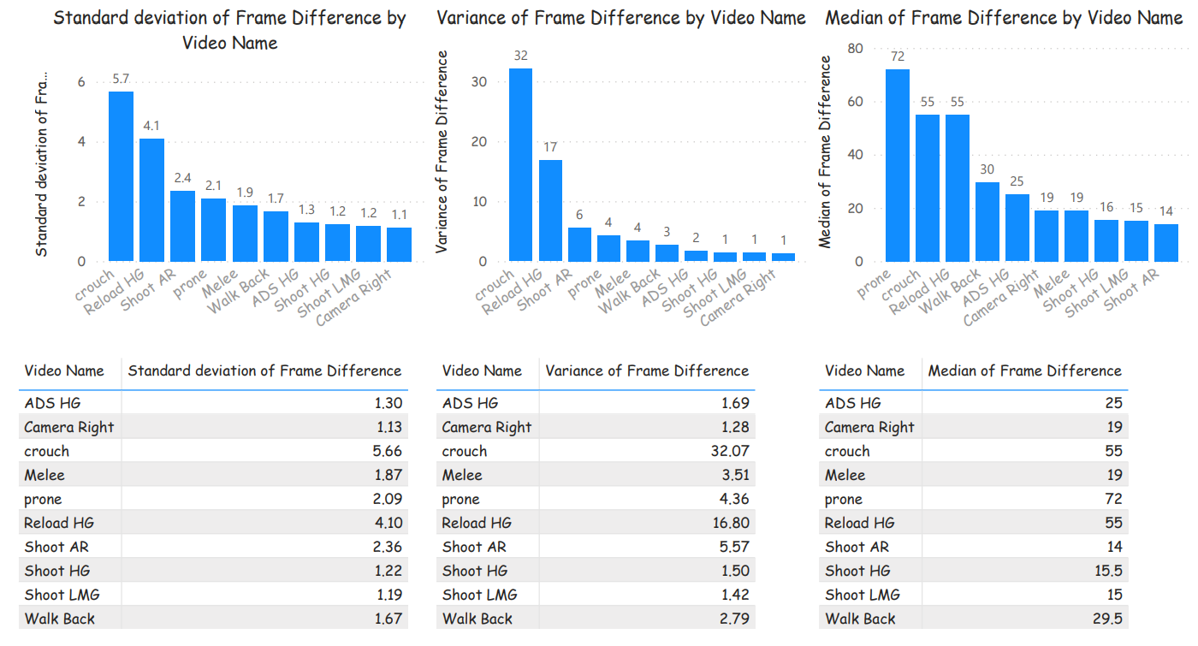

Slide 13
Stage 2
After the collection of data now the most important task was to select the model.
We used different algorithms and find the accuracy using these algorithms.

Slide 14
Model Training
Load CSV
Train model
Create ML Model
Predict Lag

Slide 15
Stage 3
User interface also a very important part of any project.
We made web app using streamlit, We provide link of web app below.
Webapp is accessible at : https://find-the-lag-iitb.streamlit.app/

Slide 16
03
Project Results

Slide 17
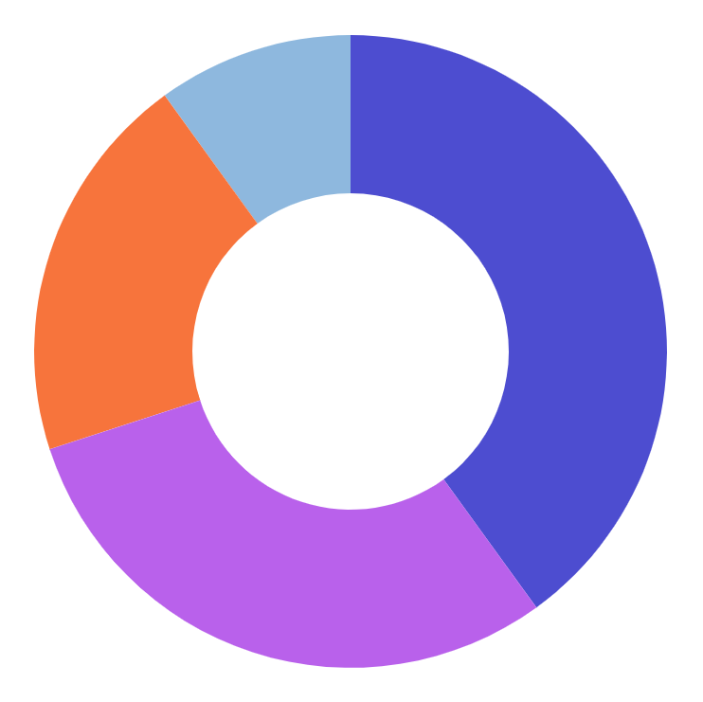
Predicted results
Linear Regression
MSE : 3.659e-16
Random Forest
MSE : 0.04484

Slide 18
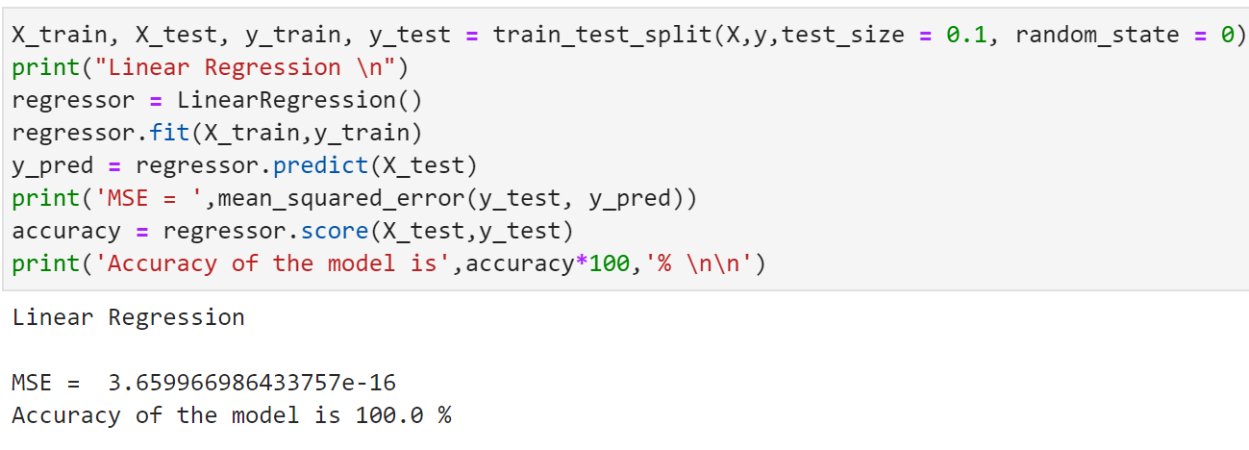
Linear Regression Results

Slide 19
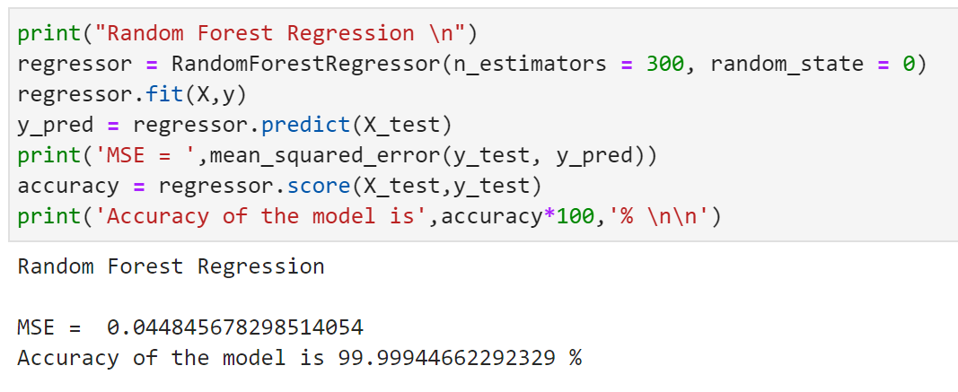
Random Forest Results

Slide 20
04
Our Team

Slide 21
Meet our team
Vansh Sharma
Bhavy Bansal
Divyansh Rohil
HA-226520

Slide 22
Thank You

